Slide 1

E-Government
Team 4 Research Project Presentation
P ADM 506: Management Information Systems (Fall 2014) Professor Jeffrey Stone
Presented by Miranda Fisher, Kory Johnson, Darlene O’Shea, Douglas Shontz & Sarah Stettler
December 12th, 2014

Slide 2
Objectives
Explain the difference between e-government and e-governance.
Provide an overview of the main uses and typical users of e-government.
Identify how e-government can improve organizational performance.
Review how e-government allows organizations to gain a competitive advantage.
Explain the impact of e-government on health organizations (Example: Kaiser Permanente)
Review some of the successes and failures related to e-government.
Outline the impact e-government has within state, local, and federal levels of government.
Identify short term and long term goals, benefits, and costs of implementing e-government.

Slide 3
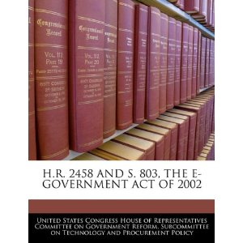
Background
Internet advancements have placed increased pressure on the public sector to serve their constituents electronically.
In 2002, the 107th Congress of the United States passed the E-government Act.
Developed as a means to “enhance the management and promotion of electronic Government services and processes by establishing a…broad framework of measures that require using Internet-based information technology to enhance citizen access to Government information and services, and for other purposes” (U.S. Government Printing Office, 2002, 1).

Slide 4
E-Government vs. E-Governance
E-Government
E-Governance
An institutional approach to jurisdictional political operations.
A procedural approach to co-operative administrative relations.
Source: Information Daily, 2006

Slide 5
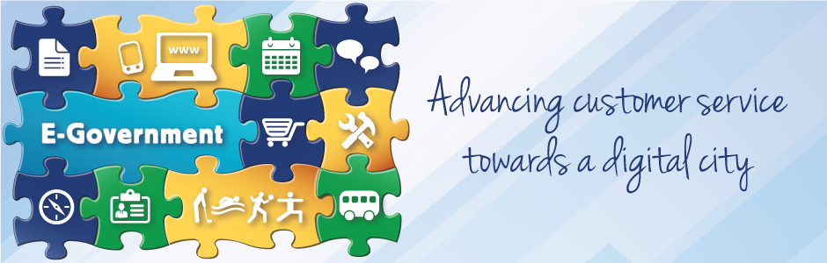
Main Uses and Users of E-Government
Main Uses of E-Government
E-Services
Typical Users of E-Government
Public Citizens
Businesses
Government Agencies
Employees
E-Democracy
E-Commerce
E-Management
The use of electronic communications to increase citizen participation in the public decision-making process.
The electronic exchange of money for goods and services.
The electronic delivery of government information, programs, and services over the Internet.
The use of information technology to improve the management of government.
Source: Dawes, 2002

Slide 6
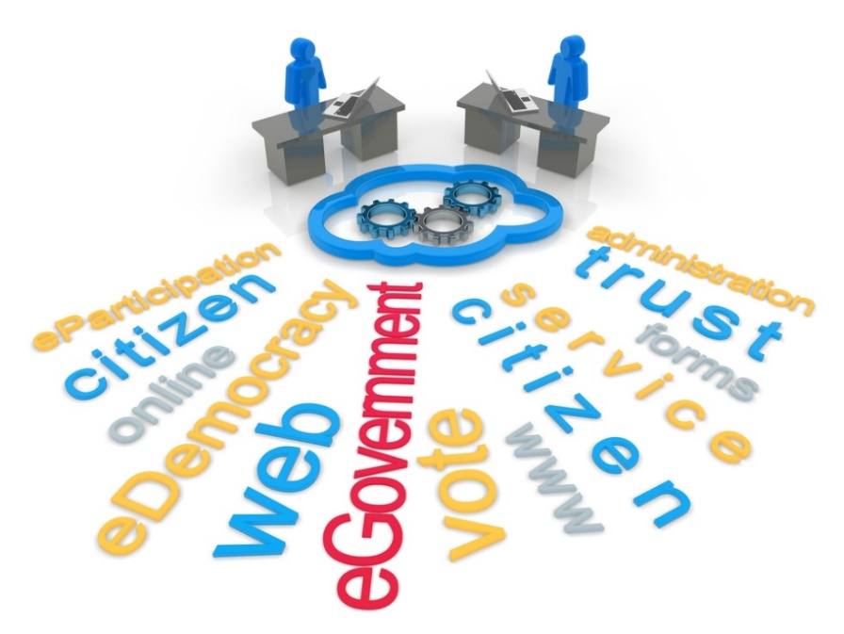
How Can E-Government Improve Organizational Performance?
Provides citizens with greater access to government.
Creates a new level of transparency.
Enhances service delivery.
Decreases the operating costs related to governmental programs.
Improves communication between state and federal agencies as well as with citizens and consumers.
Expands website accessibility by providing a means to be able to email contact information and post comments.
Allows for an increase in optimization of time management and resources.

Slide 7
Does E-Government Provide Organizations with a Competitive Advantage?
Yes! E-government can:
No! E-government can:
Lower transaction and communication costs.
Help reinvent public organizations to be more efficient and accountable to their constituents.
Increase the coordination between all levels of government providing a better service delivery model.
Be costly to develop, implement and maintain.
Open public officials up to criticism if they do not work properly.
Provide potential security issues for organizations.

Slide 8
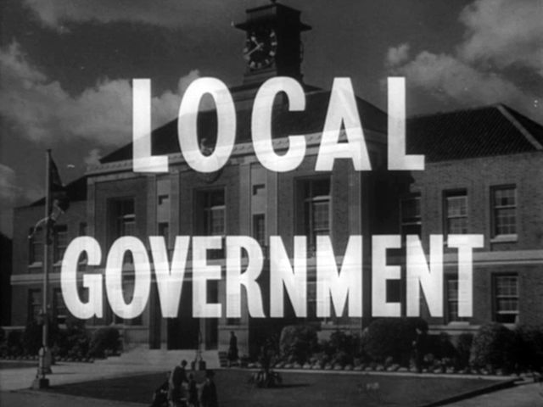
Impact of E-Government at the Local Level
Provides a chance to reinvent local government.
Ability to change (incrementally) from a standardized hierarchical organization structure to one that treats citizens like customers.
Requires increased communication from local officials and citizens.
Increases access to information.
Local governments are able to collect and process information that could help them better serve their constituents more quickly due to advancements in technology.
An e-government initiative requires the local government to explore the use of these technologies.
Improves transaction-based services.
Allows local government to complete their service delivery requirements in a more efficient and effective manner due to the development of service delivery software and applications.

Slide 9
Impact of E-Government at the State Level
Benefits:
Offers Opportunities to:
Allows for greater transparency to citizens.
Provides access to submitting governmental documents instantaneously.
Increases availability of policies in electronic format.
Examine current operations.
Identify process and procedures for streamlining.
Implement streamlining business processes.
Implement new technologies, which create improvements.
E-Verify (Enforcement Immigration Law)
“An Internet-based system that allows business to determine the eligibility of their employees to work in the United States by comparing an employee’s Social Security number and other information against millions of government records” (Feere, 2012).
Program Information:
16 states have implemented some form of this program.
It is a federally funded program, but it has an impact on the state level because many states are enacting laws based on the safeguards that the program provides.
Allows businesses securities regarding who they are hiring.
United States citizens are not overlooked for jobs.

Slide 10
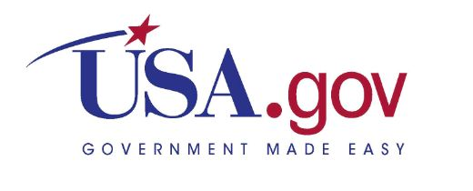
Impact of E-Government at the Federal Level
In 2008, federal agencies were critiqued and evaluators looked at 18 specific technological areas:
Publications, databases, audio clips, video clips, foreign language access, security policies, e-mail contact information, areas to post comments and handheld device accessibility.
Top ranking Federal sites:
National portal USA.gov
The Department of Agriculture
General Services Administration
Postal Service
Internal Revenue Service
Department of Education
Source: West, 2008, 1

Slide 11
Impact of E-Government on Health Organizations
E-health is defined as “a scientific context, is an emerging field in the intersection of medical informatics, public health, and business, and refers to health services and information delivered or enhanced through the Internet and related technologies” (Srinivasan, 2014).
Benefits for Patients:
Can quickly and easily access health care information.
Able to update personal information electronically.
Provides access to scheduling appointments and viewing test results online.
Benefits for Medical Staff:
Can review patient’s health care records anytime.
Allows for regular and immediate updating of health records.
Challenges:
Requires more accountability and responsibility related to security of patient’s health care records.
Errors can occur:
Inaccurate patient information can be entered.
Billing system errors can occur.
No patient information is made available.

Slide 12
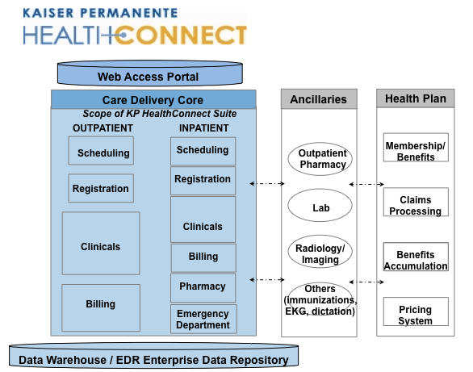
Example of an E-Health Program: Kaiser Permanente
Kaiser Permanente has the “largest nongovernmental digital depository of medical records in the world.”
In 2003, Kaiser purchased an electronic health records (EHR) system from Epic Systems, which “links Kaiser’s 37 hospitals, 15,857 physicians, and 9 million members.”
Doctors have reported being satisfied with the EHR system because it allows them to schedule appointments and labs with ease.
Kaiser members “can log into the system, check their medical records, and correspond with doctors via Epic’s secure e-mail system.”
Source: Leonard & Tozzi, 2012

Slide 13
Short Term and Long Term Goals, Benefits and Costs of Implementing E-Government
Costs
According to the Massachusetts Executive Office for Administration and Finances, it could cost a state government around $250 million to implement multiple e-government programs over a five year period (Commonwealth of Massachusetts, 2014).
Expense are typically related to:
Technological advancements needed.
The cost of hiring personnel who would be able to make the necessary changes.
Short Term Goals and Benefits
Advancements in terms of providing increased access and transparency to citizens.
Ensuring that “customers will have access to eGovernment services at times and locations of their choosing, taking into account special needs and social, economic and ethnic considerations” (Montserin).
An emergence of social media utilized in combination with e-government as a means to disseminate information, especially communication related to disaster management (Magro, 2012).
Long Term Goals and Benefits
Reach a stage where government is viewed as an interactive democracy that allows “citizens [to] order and execute…services alone and start to manipulate informational databases” (West, 2004, 17).
Focus on convenience, improved quality of customer service, and higher quality in information (Commonwealth of Massachusetts, 2014).
Emphasis on the New Public Service model where the citizen are viewed and treated as customers.

Slide 14
Successes and Failures of E-Government
Success
Failures
89% of the websites can be fully accessed because more than half of the websites provide e-mail addresses, message boards, or chat room.
In 2010, more than 6.5 million individuals visited a federal website.
12 million bulletins were sent out in 2010, notifying citizens of updates to site content, ensuring that they receive the most accurate information.
Federal government launched a Twitter account that has more than 4,500 followers.
E-government has been criticized in its failure to reach underdeveloped countries.
More than half of websites are written at a 12-grade reading level, even though most adults read at an 8th-grade reading level (Safeer & Keenan, 2005).
Less than a quarter of the websites are accessible to individuals with various disabilities.
Only 3% of websites ware accessible through hand-held devices and lack appropriate navigation tools to make them user friendly (West, 2008).

Slide 15

Conclusion
As we continue to dive into a world that is inundated with technological advancements, we will continue to see an expansion in the “the delivery of government information and services online through the Internet or other digital means” (Plant, 2014).
E-government has come a long way from its original stage when enacted into law in 2002 and has proven to be invaluable when it comes to improving communication, transparency, and accessibility to citizens and businesses alike.
Within all levels of government and various other public and private sectors, e-government has been able to improve the way in which these organizations function and allow them to gain a competitive advantage within their respective markets.
E-government is only just beginning and in the years to come, we will see significant transformations in the way in which e-government improves its relationships with other governmental entities, businesses, and the general public.

Slide 16
References
American Public Works Association. (2014). Retrieved from http://www.apwa.net/
Aydinli, O.F, Brinkkemper, S & Ravesteyn, P. (2009). Business process improvement in organizational design of eGovernment services. Electronic Journal of e-Government (Vol. 7, Issue 2), 123 – 134. Retrieved from www.ejeg.com/issue/download.html?idArticle=167
Brannen, A. (2001). “E-Government” in California: Providing services to citizens through the Internet. Legislative Analyst’s Office. Retrieved from http://www.lao.ca.gov/2001/012401_egovernment.html
Commonwealth of Massachusetts. (2014). Section 2: The benefits of e-government. Massachusetts Executive Office for Administration and Finances. Retrieved from http://www.mass.gov/anf/research-and-tech/it-planning-and-collab/strat-planning/prev-plans/e-gov-strat-plan/section-2-the-benefits-of-e-government.html
Crosby, B. C. (2010). Leading in the shared-power world of 2020. Public Administration Review, 70(S1), S69-S77
Dawes, Sharon. (2002). The future of e-government. Center for Technology in Government. Retrieved from http://www.ctg.albany.edu/publications/reports/future_of_egov
Denhardt, J.V. & Denhardt, R.B. (2011). The New Public Service: Serving, Not Steering. Armock, New York: M.E. Sharpe, Inc.
Executive Office of the President of the United States. (2010). Report to Congress on the benefits of the e-government initiatives: Fiscal year 2010. Retrieved from http://www.whitehouse.gov/sites/default/files/omb/assets/egov_docs/FY10_E-Gov_Benefits_Report.pdf
Feere, J. (2012). An overview of E-Verify policies at the state level. Center for Immigration Studies. Retrieved from http://www.cis.org/e-verify-at-the-state-level
IGI Global. (2014). Government to business (G2B). Retrieved from http://www.igi-global.com/dictionary/government-to-business-g2b/12391
IGI Global. (2014). Government to citizens (G2C). Retrieved from http://www.igi-global.com/dictionary/government-to-citizen-g2c/12392
IGI Global. (2014). Government to employees (G2E). Retrieved from http://www.igi-global.com/dictionary/government-to-employees-g2e/12393
IGI Global. (2014). Government to government (G2G). Retrieved from http://www.igi-global.com/dictionary/government-to-government-g2g/12394
Information Daily. (2006). Comparing e-government vs. e-governance. Information Daily. Retrieved from http://www.theinformationdaily.com/2006/07/03/comparing-e-government-vs-e-governance
Laudon, K.C. & Laudon, J.P. (2015). Essentials of Management Information Systems (11th ed.), Upper Saddle River, NJ: Prentice Hall.
Leonard, D. & Tozzi, J. (2012, June 21). Why don’t more hospitals use electronic health records? Bloomberg Businessweek. Retrieved from http://www.businessweek.com/articles/2012-06-21/why-dont-more-hospitals-use-electronic-health-records
Magro, M.J. (2012). A review of social media use in e-government. Administrative Sciences. Retrieved from http://www.mdpi.com/2076-3387/2/2/148/pdf
Maron, D.F. (2013, June 7). How social media is changing disaster response. Scientific American. Retrieved from http://www.scientificamerican.com/article/how-social-media-is-changing-disaster-response/
May, A. (2013, Nov 20). What went wrong with HealthCare.gov – and what now. BenefitsPro. Retrieved from http://www.benefitspro.com/2013/11/20/what-went-wrong-with-healthcaregov-and-what-now
McCann, E. (2013, Jan 1). 10 largest HIPAA breaches of 2012. Healthcare IT News. Retrieved from http://www.healthcareitnews.com/news/10-largest-hipaa-breaches-2012
Montserin, A. The importance and objectives of e-government. Caribbean Centre for Development Administration. Retrieved from https://www.caribank.org/uploads/news-events/events/past-conferences-and-workshops/regional-icts-workshop/Montserin-CARICAD.pdf
New York State Office of Mental Health. (2012). Health Insurance Portability and Accountability Act (HIPAA). Retrieved from https://www.omh.ny.gov/omhweb/hipaa/
Norris, F. D. and Reddick G. C. (2012). Local government in the United States: Transformation or incremental change? Public Administrative Review, 73.
Plant, J. (2014). What is e-government? Lesson 10: E-Government and technological change. Retrieved from Lecture Notes on Online Website: https://courses.worldcampus.psu.edu/fa14/padm500/001/content/10_lesson/03_page.html
Roberts, C. N. (2011). Beyond smokestacks and silos: Open-source, web-enabled coordination in organizations and networks. Public Administrative Review.
Safeer, R.S. & Keenan, J. (2005). Health Literacy: The Gap Between Physicians and Patients. Retrieved from http://www.aafp.org/afp/2005/0801/p463.html
Srinivasan, D. (2014). The Impact of Trust in E-Government on Electronic Health Literacy. World Medical & Health Policy, 6: 22–38.doi: 10.1002/wmh3.86
Tat-Kei Ho, A. (2002). Reinventing local governments and e-government initiative. Public Administrative Review. Retrieved from http://www.jstor.org/stable/31100358
U.S. Government Printing Office. (2002, Dec. 17). Public Law 107-347. 107th Congress. Retrieved from http://www.gpo.gov/fdsys/pkg/PLAW-107publ347/pdf/PLAW-107publ347.pdf
West, D. M. (2004). E-government and the transformation of service delivery and citizen attitudes. Public Administration Review, 64(1), 15-27.
West, D.M. (2005). Digital government: Technology and public sector performance. Princeton University Press. Retrieved from http://press.princeton.edu/chapters/s8088.html
West, D.M. (2008). State and federal electronic government in the United States, 2008. The Brookings Institute. Retrieved from http://www.brookings.edu/~/media/events/2009/6/17%20public%20sector%20tech/0826_egovernment_west.pdf
White House (2012). Federal IT Shared Services Strategy. Retrieved fromhttp://www.whitehouse.gov/sites/default/files/omb/assets/egov_docs/shared_services_strategy.pdf

